Slide 1
PP_Module 5.3

Slide 2
Data description
The numerical findings of a study should be presented clearly, concisely, and in such a manner that an observer can quickly obtain a feel for the essential characteristics of the data.
Over the years it has been found that tables and graphs are particularly useful ways of presenting data, often revealing important features such as the range, the degree of concentration, and the symmetry of the data.
Now we will discuss some common graphical and tabular ways for presenting data.

Slide 3
DESCRIBING DATA SETS
Frequency Tables and Graphs_Line,Bar,Pie
Grouped Data_Scatter Plots
Histograms

Slide 4
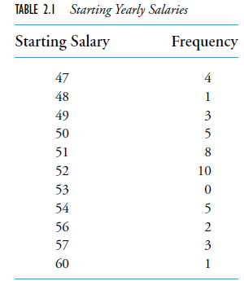
Frequency Tables and Graphs
Frequency table for a data set consisting of the starting yearly salaries (to the nearest thousand dollars) of 42 recently graduated students

Slide 5
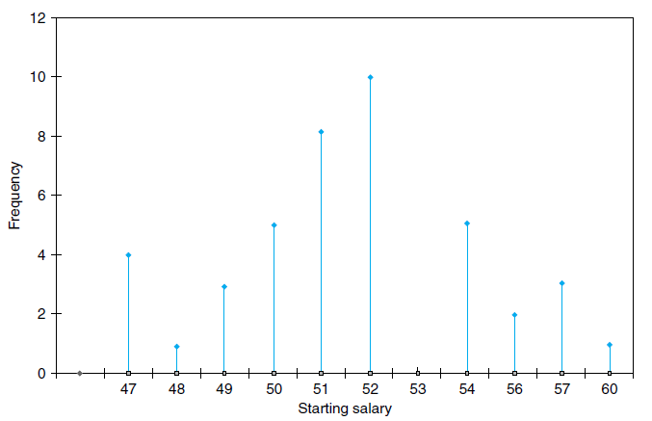
Line graph

Slide 6
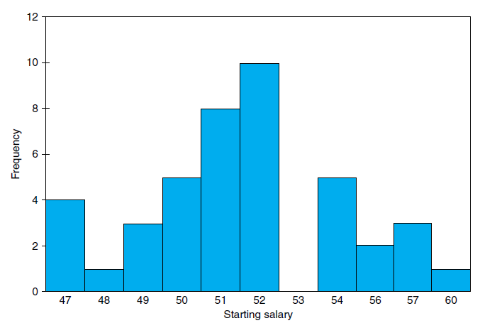
Bar graph

Slide 7
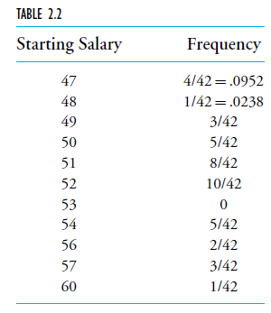
Relative Frequency Tables and Graphs
Consider a data set consisting of n values. If f is the frequency of a particular value, then the ratio f /n is called its relative frequency

Slide 8
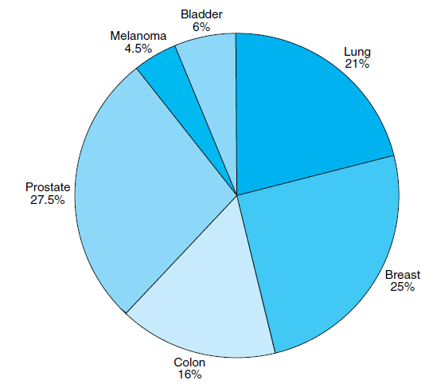
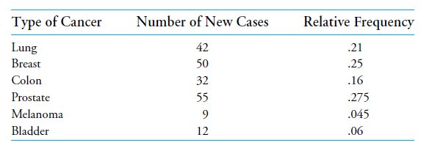
Pie Chart

Slide 9
Grouped Data, Histograms
Divide the values into groupings, or class intervals, and then plot the number of data values falling in each class interval
The endpoints of a class interval are called the class boundaries
We will adopt the leftend inclusion convention

Slide 10
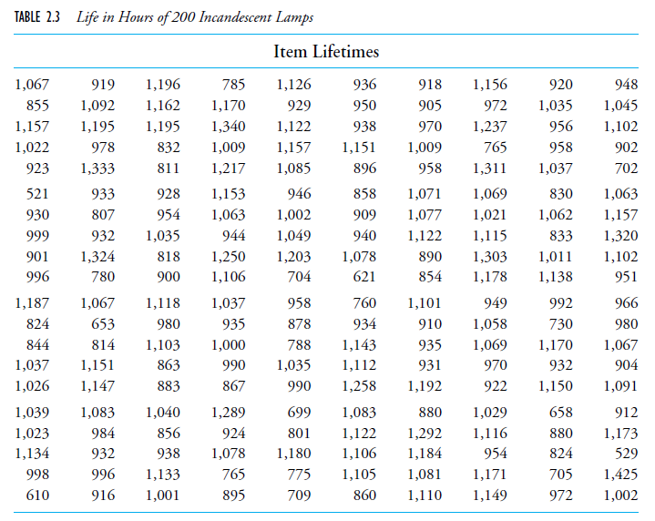

Slide 11
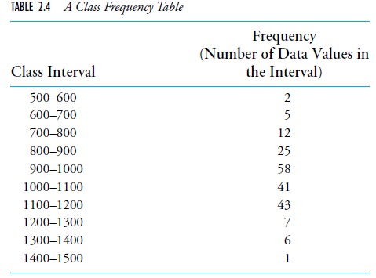
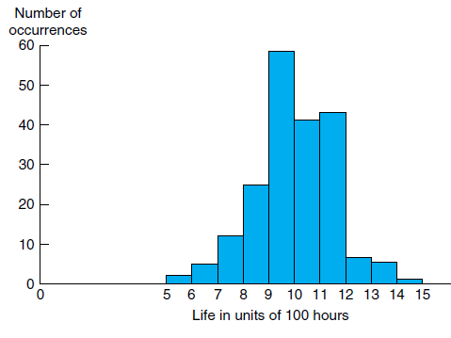
Histogram
Frequency histogram
Notes:
A bar graph plot of class data, with the bars placed adjacent to each other, is called a histogram

Slide 12
PAIRED DATA SETS
Sets that consist of pairs of values that have some relationship to each other
Data set of paired values is to plot the data on a two dimensional graph,
The x-axis representing the x value of the data
The y-axis representing the y value. Such a plot is called a scatter diagram

Slide 13
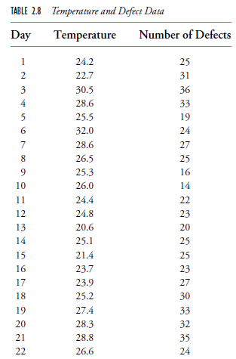

Slide 14
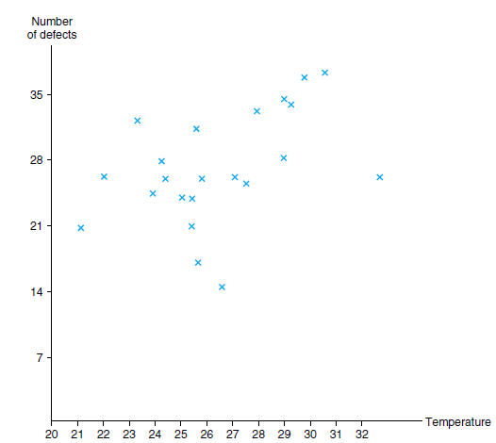
Scatter Diagram

Slide 15
Matplot library
Matplotlib is a plotting library for the Python programming language and its numerical mathematics extension NumPy.
It provides an object-oriented API for embedding plots into applications

Slide 16
Python Matplotlib
Markers
line
labels
grid
subplot
scatterplot
histogram
bar chart
pie charts

Slide 17
Python Matplotlib
Matplotlib is a comprehensive library for creating static, animated, and interactive visualizations in Python. Matplotlib makes easy things easy and hard things possible.
Important Types of Plots
Line chart
Bar graphs
Histograms
Scatter plots

Slide 18
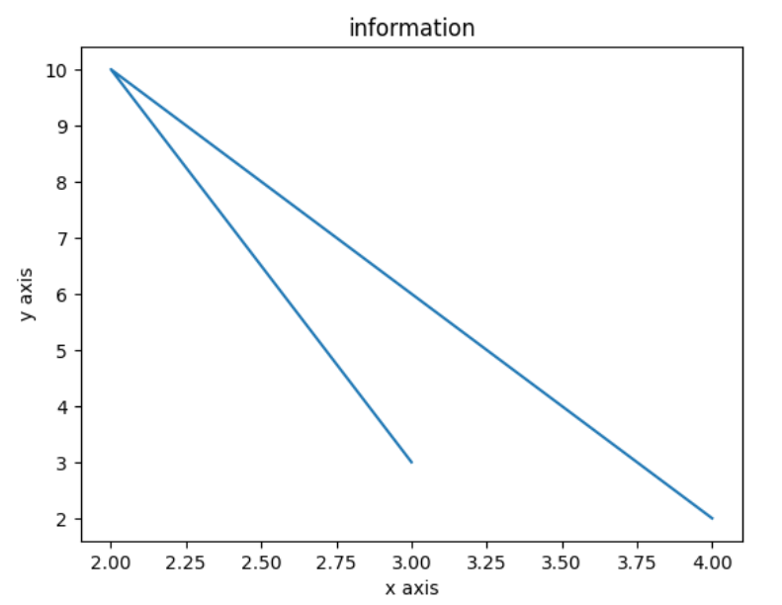
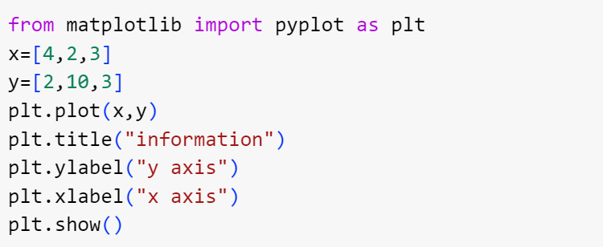
Line graph

Slide 19
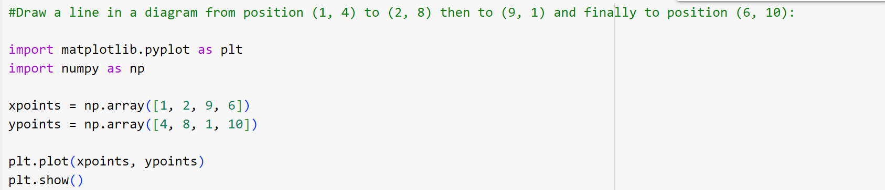
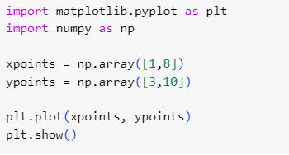
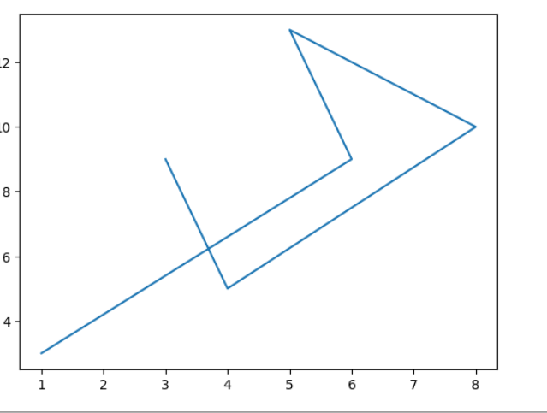
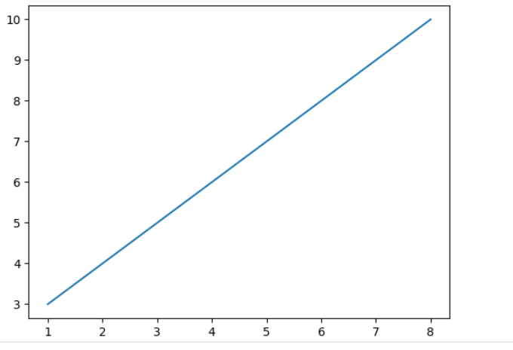
Examples:
Draw two points in the diagram, one at position (1, 3) and one in position (8, 10):
The plot() function is used to draw points (markers) in a diagram.
By default, the plot() function draws a line from point to point.
Parameter 1 is an array containing the points on the x-axis.
Parameter 2 is an array containing the points on the y-axis.

Slide 20
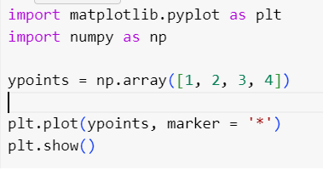
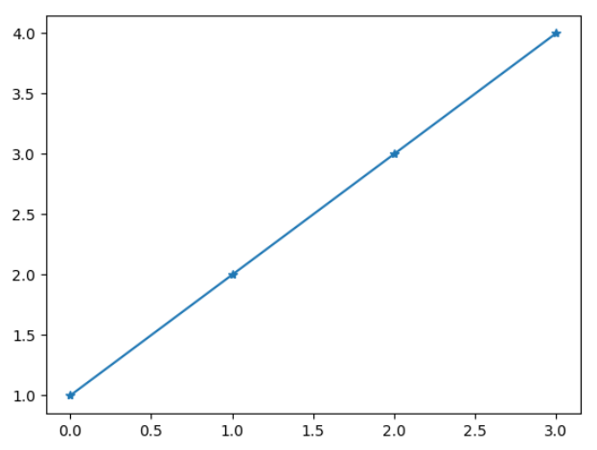
Markers and grids
Marker list
o | Circle
* | Star
. | Point
p | Pixel
x/X | X
+/p | Plus
s | Square
d/D | Diamond
p | Pentagon
H/h | Hexagon
v/^ | Triangle down/up
</> | Triangle Left/right
1/2 /3/4 | Tri up/down/left/right
| | Vline
_ | Hline

Slide 21
Marker formatting: colour, line style, marker size(use ms)
Line options(line style is written as ls)
Colour options
'-.' | Dashed/dotted line
'--' | Dashed line
':' | Dotted line
'-' | Solid line
r | Red
g | Green
B | Blue
C | Cyan
m | Magneta
y | Yellow
K | Black
w | White
plt.plot(ypoints, linewidth = '20.5') plt.show()

Slide 22
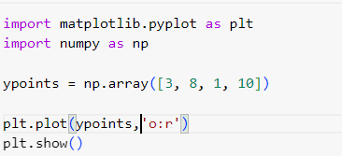
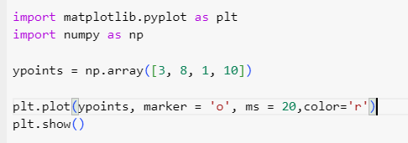
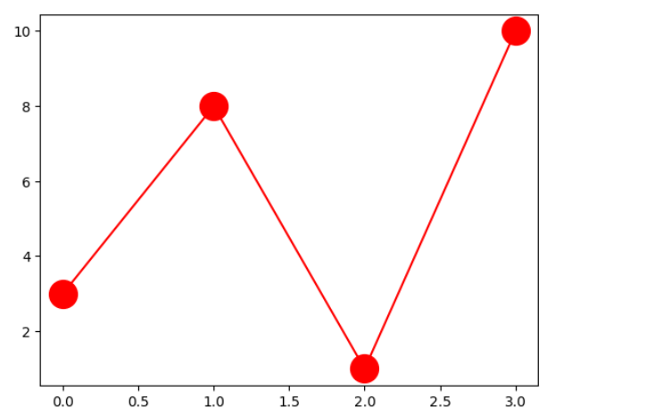
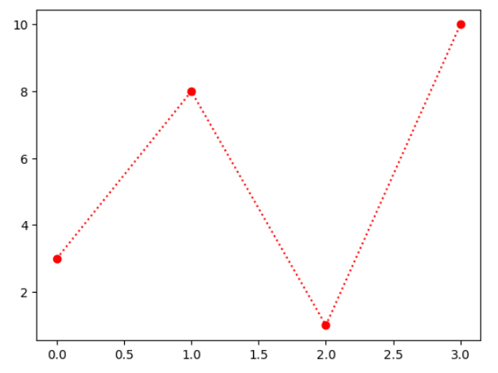
Examples:

Slide 23
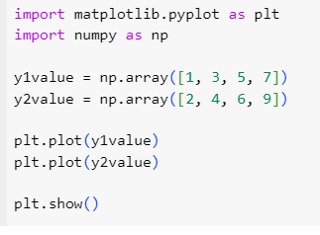
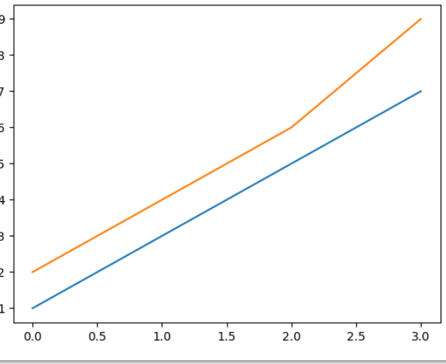
Multiple lines (use plt.plot())

Slide 24
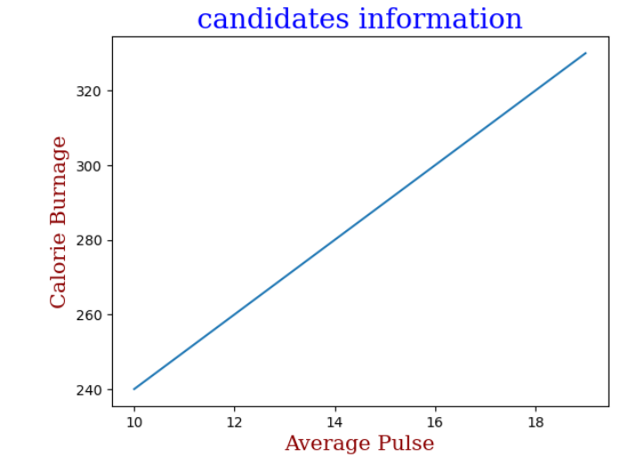
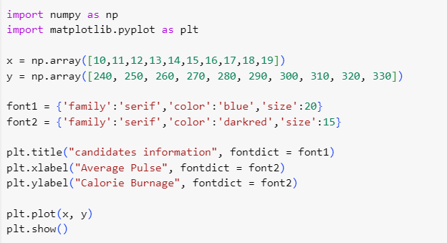
Formatting of titles and labels

Slide 25
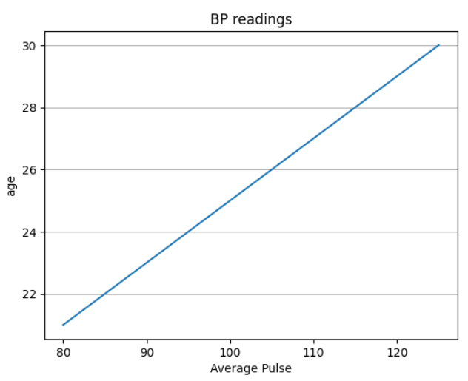
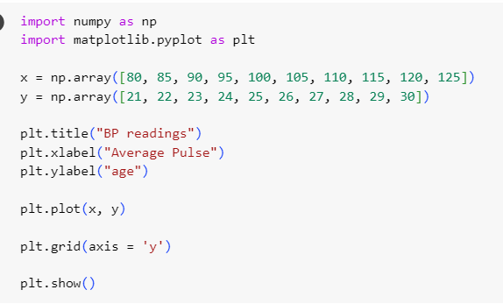
Grid lines (use plt.grid)

Slide 26
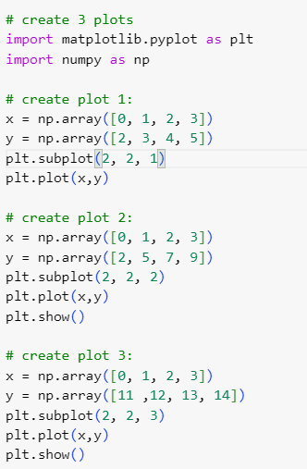
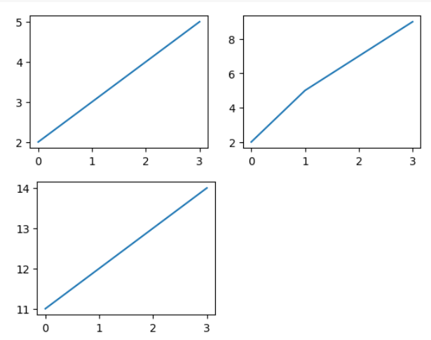
Create multiple plots using subplot

Slide 27
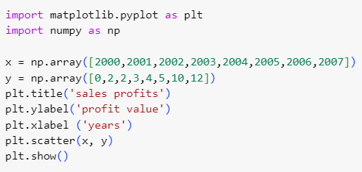
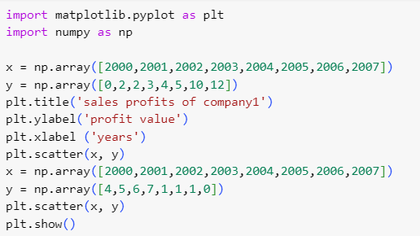
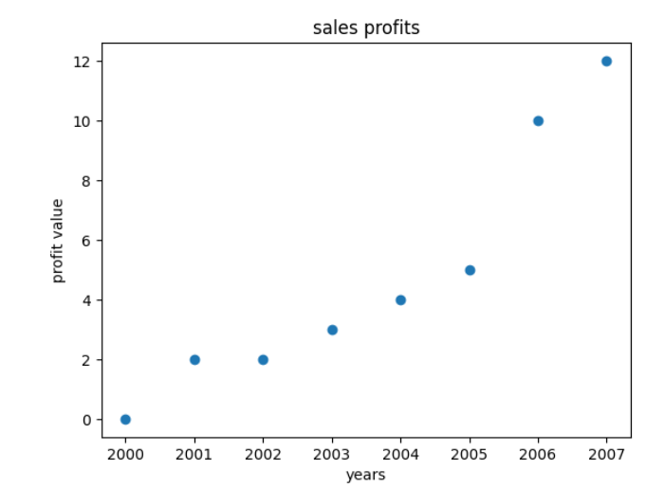
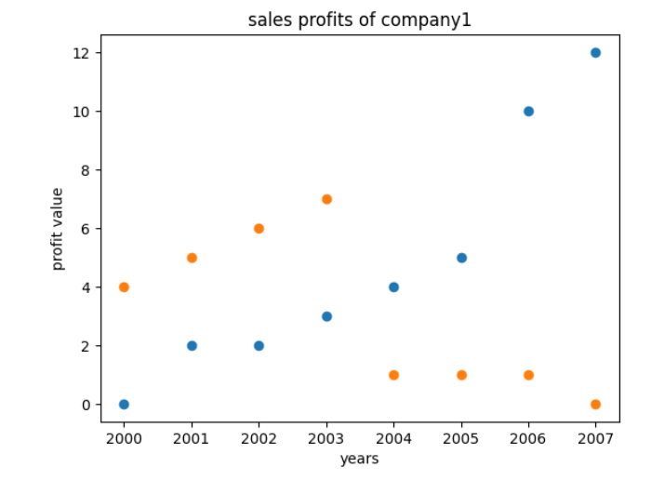
Create scatter plot(use the scatter() function)

Slide 28
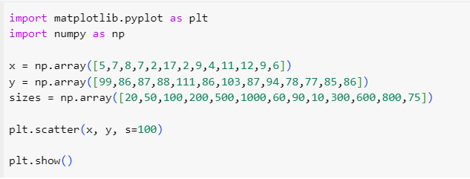
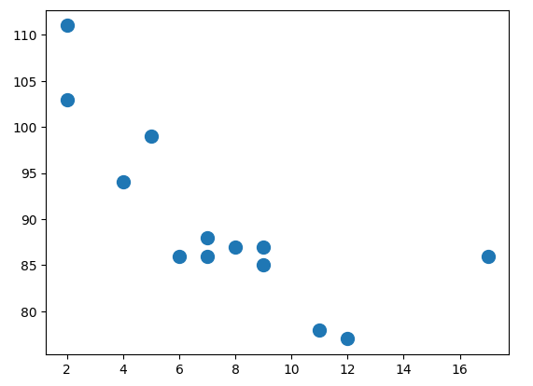
Change the size of scatterplot

Slide 29
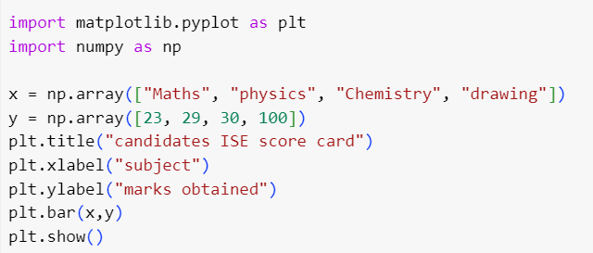
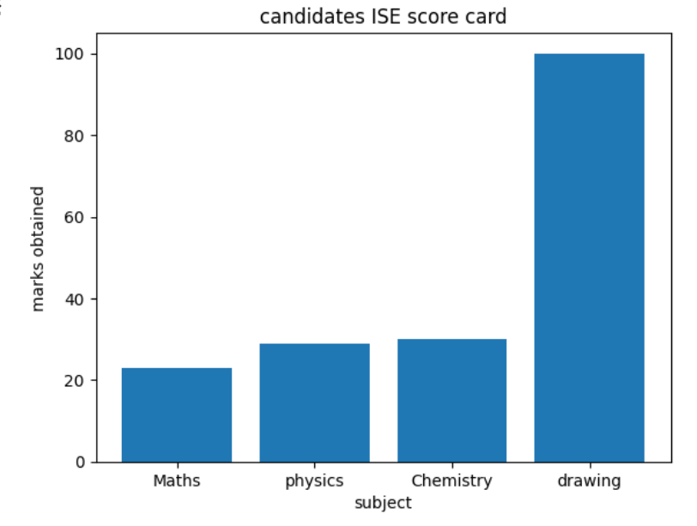
Creating Bars
Change colour using color example-plt.bar(x, y, color = "red") change widh example: plt.bar(x, y, width = 0.1)

Slide 30
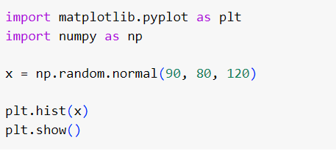
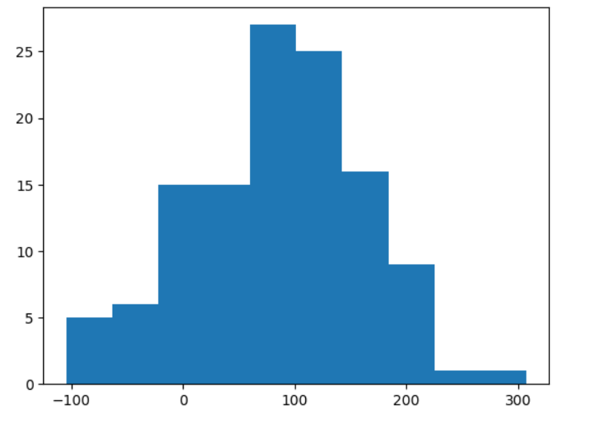
Histogram : to show frequency distributions

Slide 31
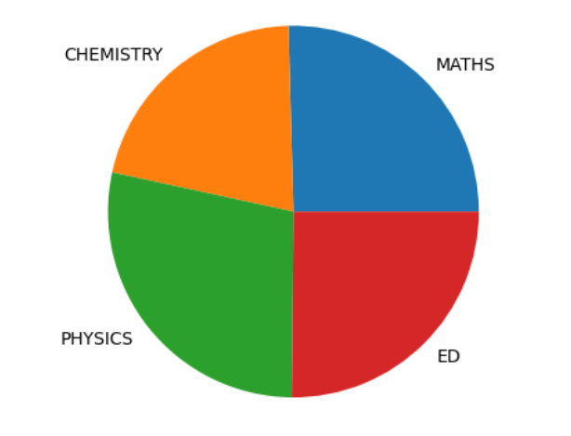
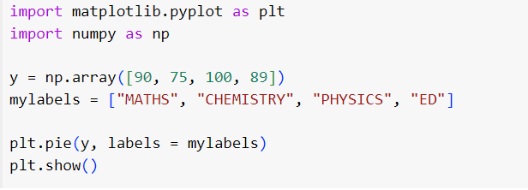
Pie Charts (use the pie() function to draw pie charts)

Slide 32
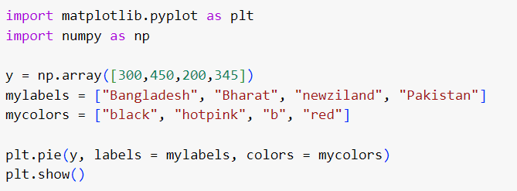
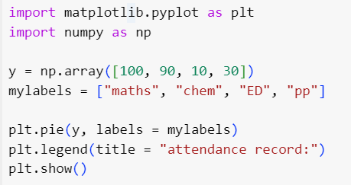
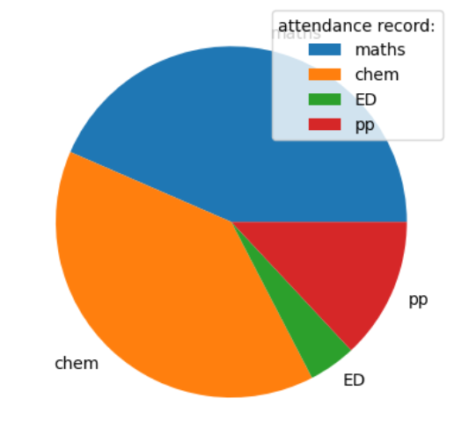
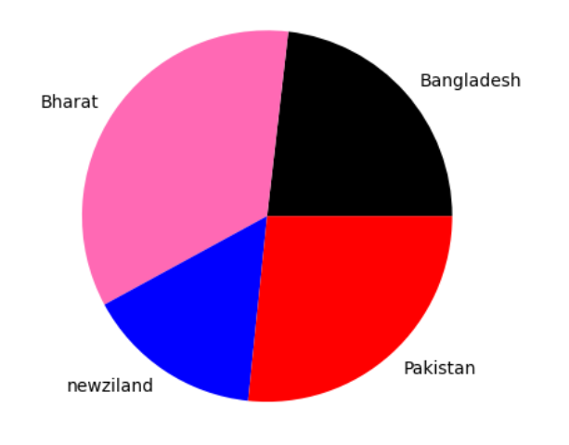
Settings: Colour, legend

Slide 33
References
https://www.w3schools.com/python/matplotlib_pyplot.asp
https://www.simplilearn.com/tutorials/python-tutorial/matplotlib

